Slide 1
UCoAt CycleGAN: UNet based CoAt Cycle GAN
Presented By:
Boqi Zhao, Yingwei Song,
Yiyang Wang, Zhaoyang Li

Slide 2
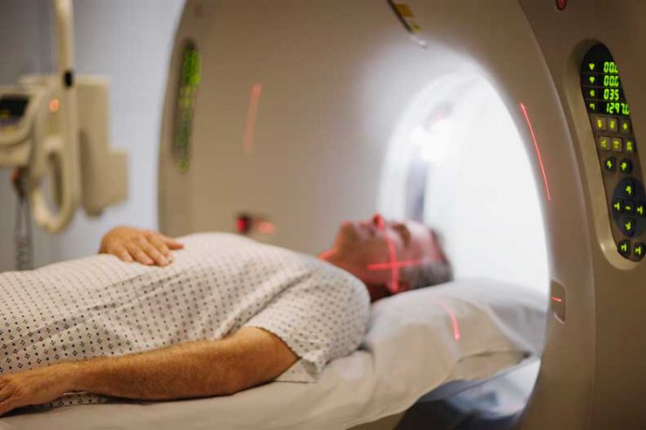
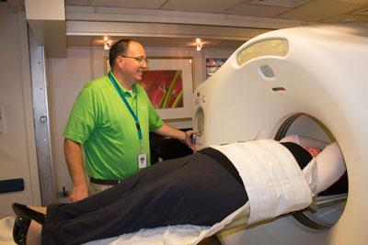
Introduction
MR(magnetic resonance) Image
MR/PET System
PET(positron emission tomography) Image
Cost: $1325
Cost: $5750
Highly Radioactive

Slide 3
Introduction
1. Introduce the GANs model to the cycle conversion of MR and PET images
2. Incorporating MobileNetV2 and Relative Attention
3. Using the architecture of CycleGAN

Slide 4
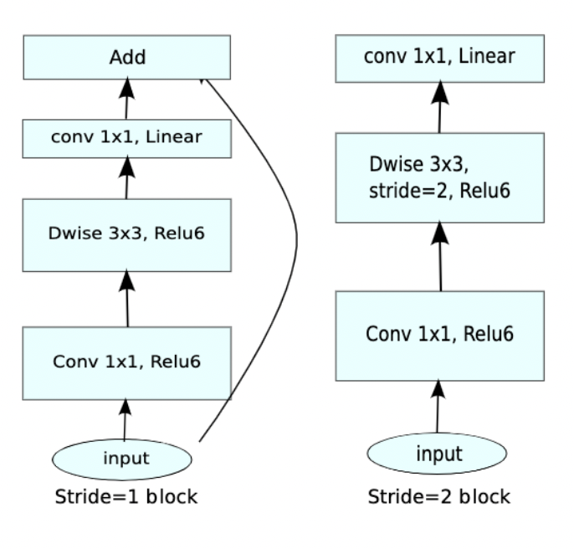
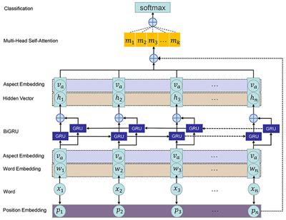
Related Work
CoAtNet: 1) MobileNetV2
2) Self-attention with Relative Position Representation

Slide 5
Related Work
U-Net: 1) Encoder (contracting path) and Decoder (expansive path)
2) Skip Connection: provide additional information helping the decoder to generate better features. It also helps the indirect flow of gradients to earlier layers.
3) Bridge: connecting the encoder and decoder, and completing the flow information

Slide 6
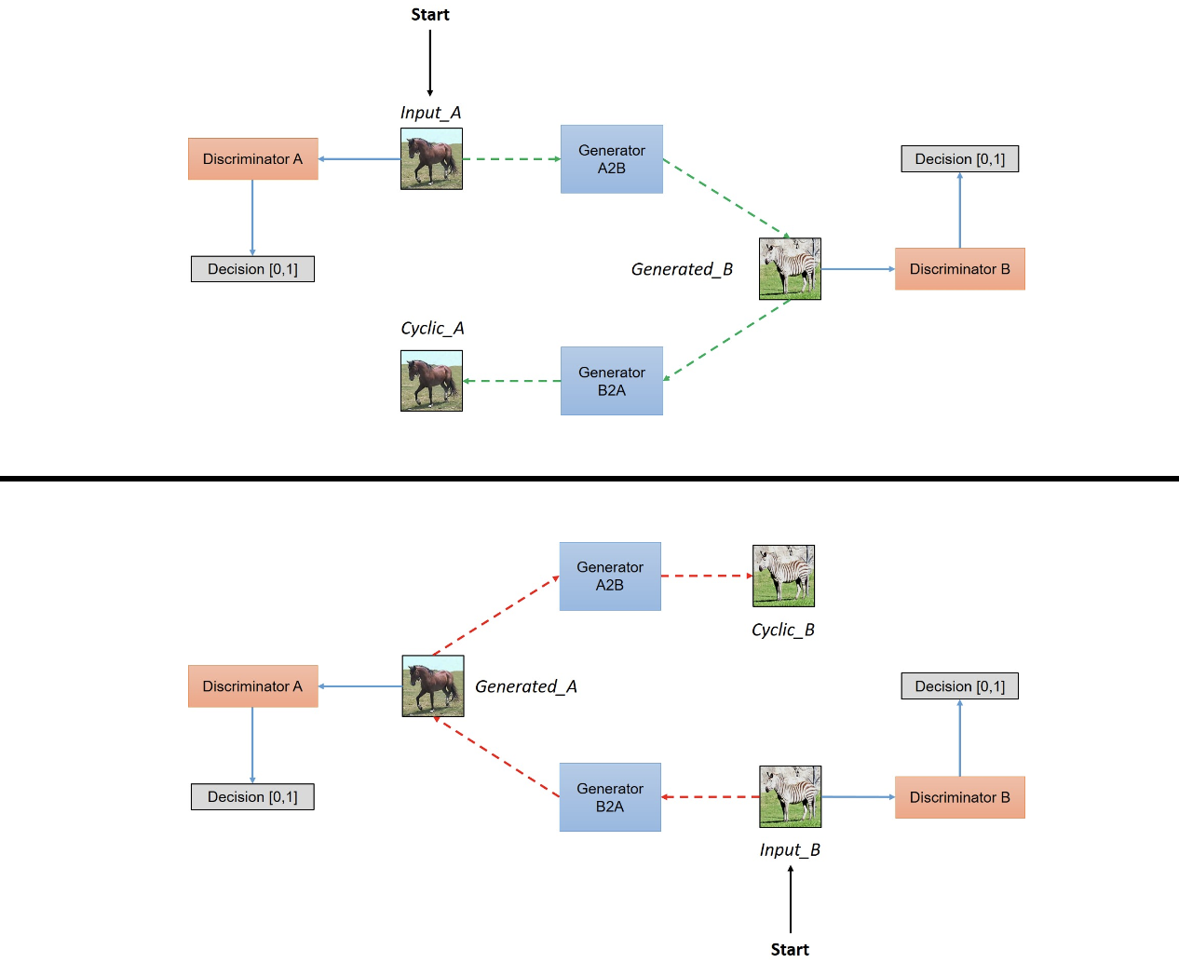
Related Work
CycleGAN:
Achieving the goal of learning a mapping G: X->Y such that the distribution of images from G(X) is indistinguishable from the distribution of Y using an adversarial loss, coupling it with an inverse mapping
F: Y->X
Using a cycle consistency loss to push F(G(X))≈X and G(F(Y)≈Y.

Slide 7
Related Work
WGAN-GP (Wasserstein GAN + Gradient Penalty):
Replacing weight clipping with gradient penalty.
Resolving gradient disappearance or gradient explosion
Create a complex boundary to surround the modes of the model.

Slide 8
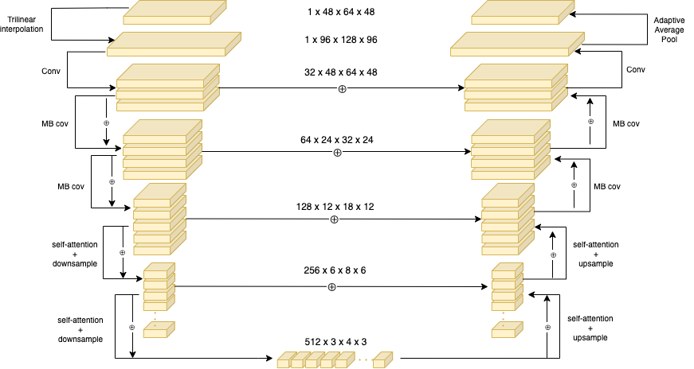
Architecture
Generator

Slide 9
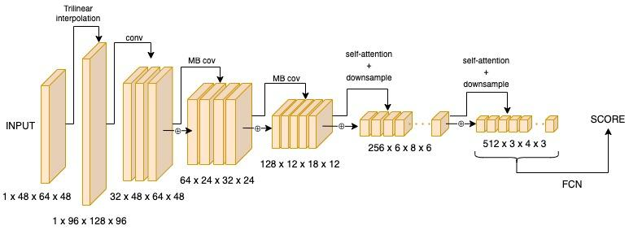
Architecture
Discriminator

Slide 10
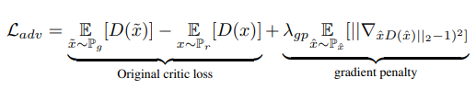
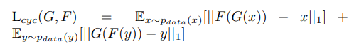
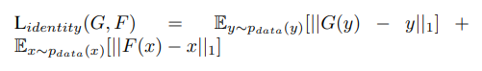
Loss
Adversarial Loss
Cycle Consistency Loss
Identity Loss

Slide 11
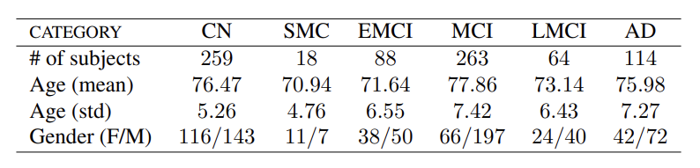
Dataset
The Alzheimer’s Disease Neuroimaging Initiative (ADNI)
Total Number: 810 pairs of PET and MR

Slide 12
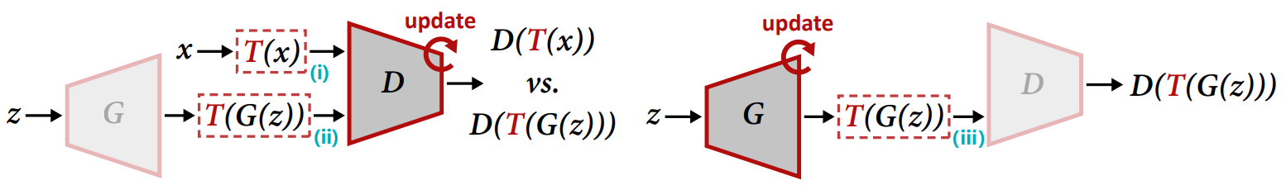
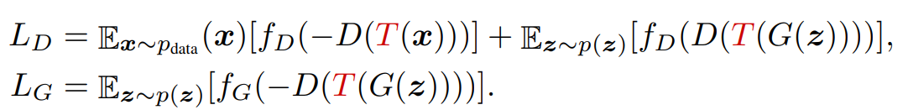
Differentiable Augmentation
Dataset: The Alzheimer’s Disease Neuroimaging Initiative (ADNI)
Shengyu Zhao, Zhijian Liu, Ji Lin, Jun-Yan Zhu, and Song Han. Differentiable augmentation for dataefficient gan training. arXiv preprint arXiv:2006.10738, 2020.

Slide 13
Training Policy
Train with 200 epochs
We initialize learning rate with 1e-4 and using cosine learning rate decay
We initialize standard cycleGAN hyperparameters including lambda_indentity = 0.5 and lambda_cycle = 10.
For gradient penalty, we set the lambda which is 10

Slide 14
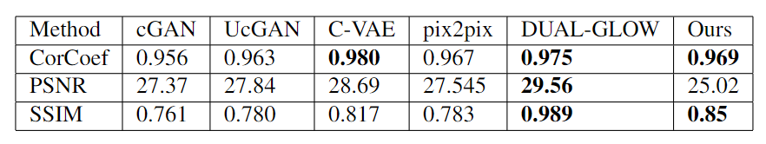
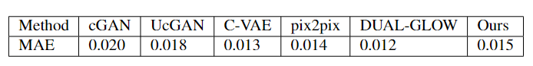
Quantitative Result
scores of measurements
MAE

Slide 15
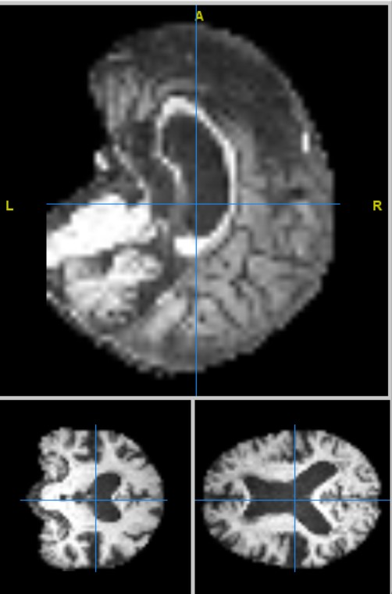
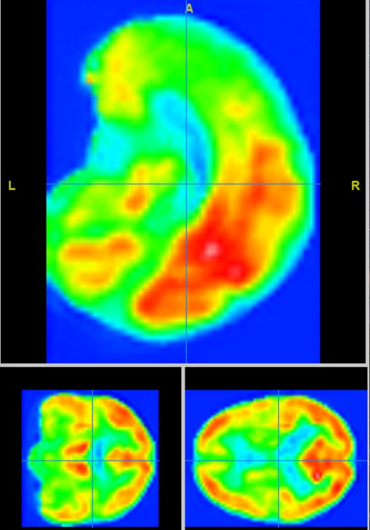
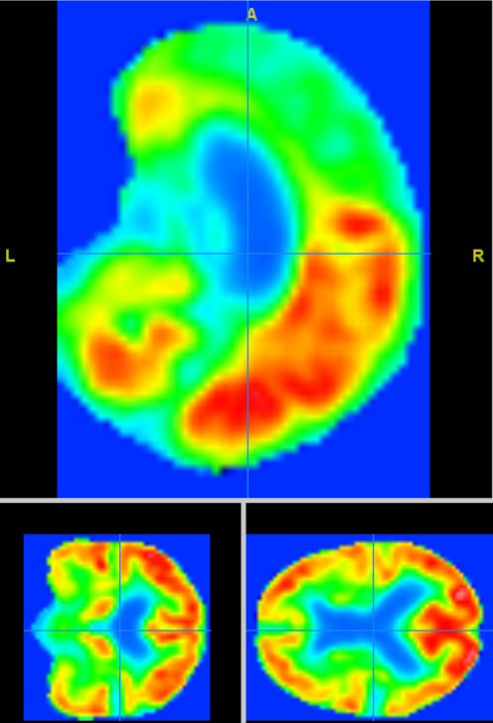
generate
Input: MRI
Output: Fake PET
Real PET

Slide 16
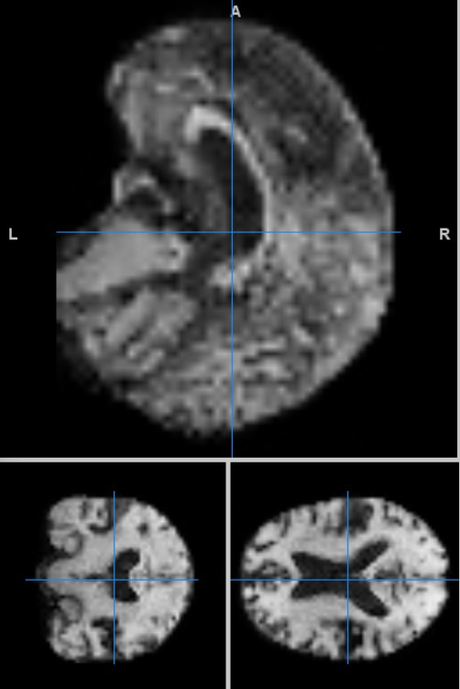
generate
Input: PET
Output: Fake MRI
Real MRI

Slide 17
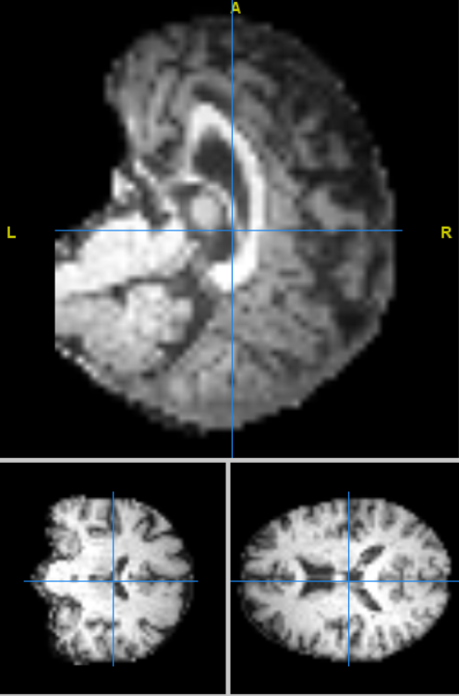
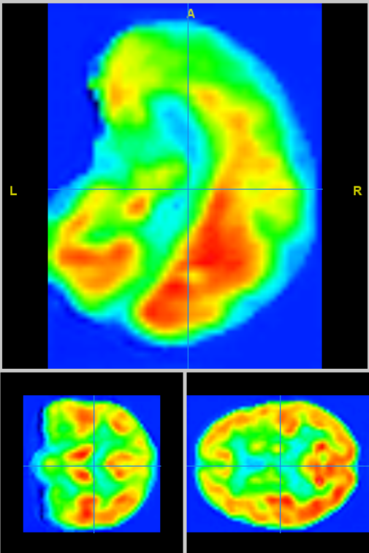
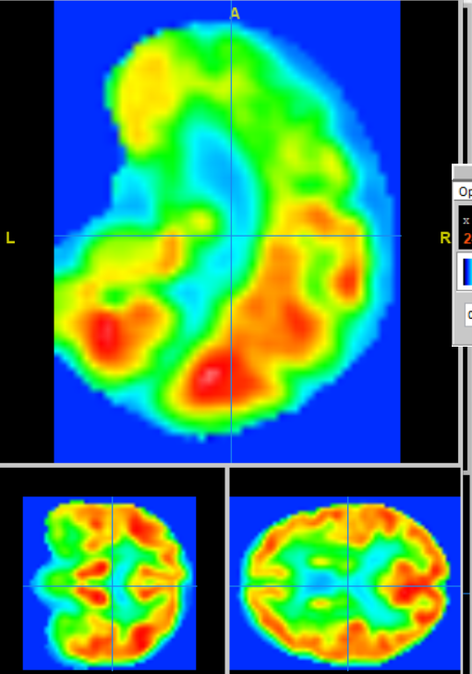
generate
Input: MRI
Output: Fake PET
Real PET

Slide 18
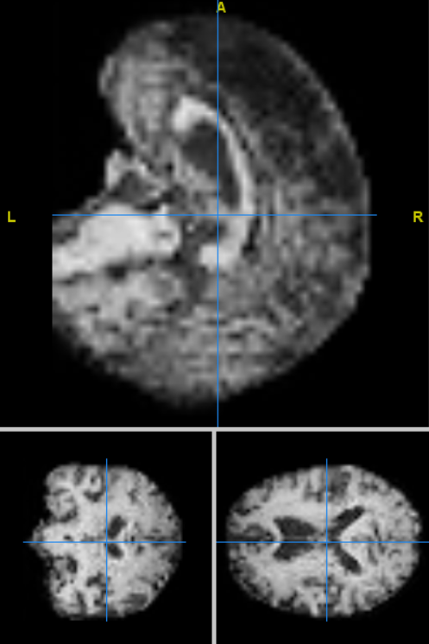
generate
Input: PET
Output: Fake MRI
Real MRI

Slide 19
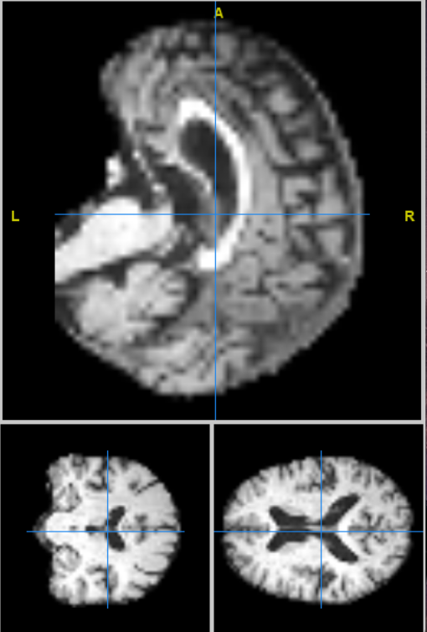
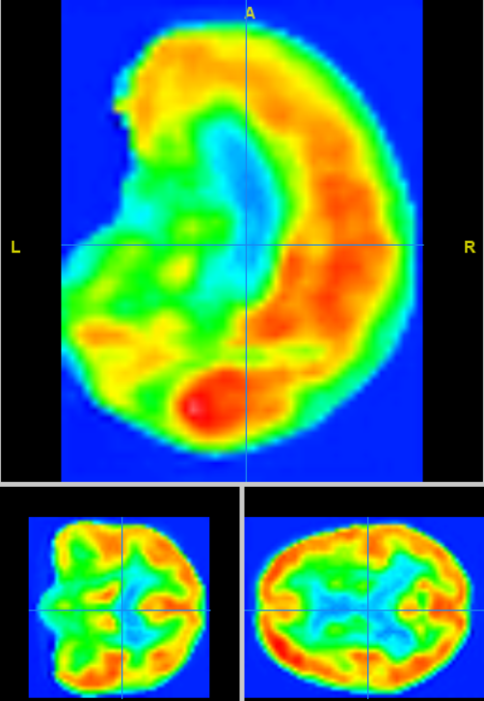
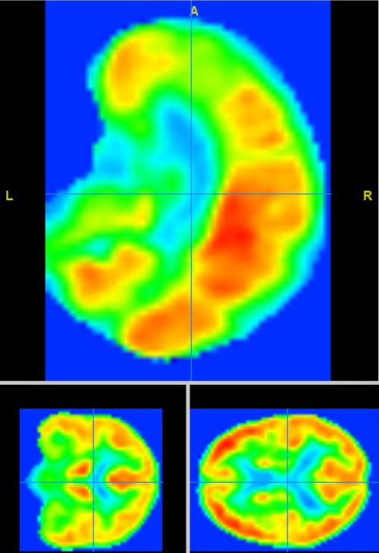
generate
Input: MRI
Output: Fake PET
Real PET

Slide 20
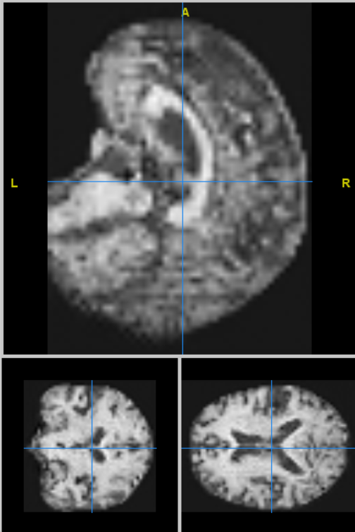
generate
Input: PET
Output: Fake MRI
Real MRI

Slide 21
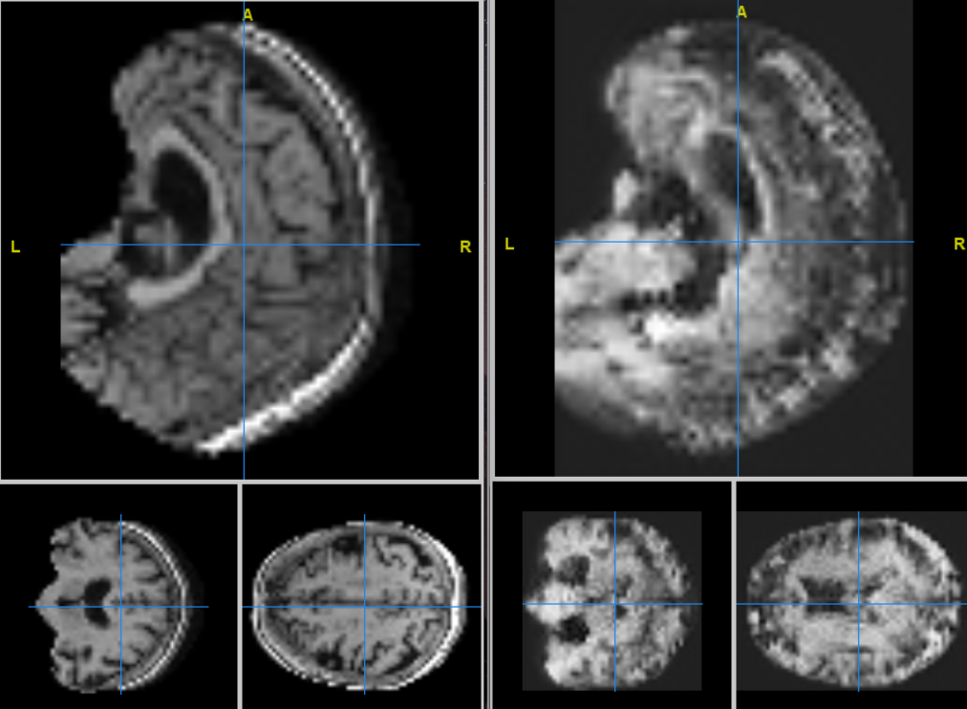
Failure cases
real MRI
fake MRI

Slide 22
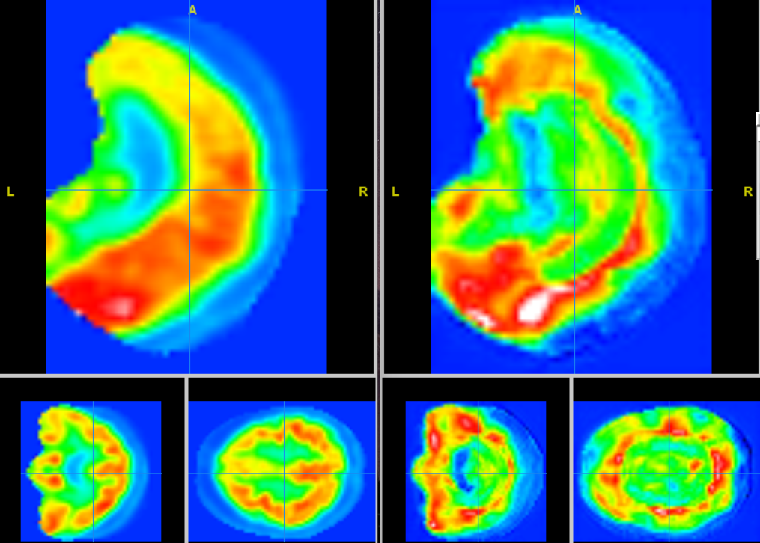
Failure cases
real PET
fake PET

Slide 23
MRI
fake PET
real PET
MRI
fake PET
real PET

Slide 24
PET
fake MRI
real MRI
PET
fake MRI
real MRI

Slide 25
Strengths
Convolution + Relative Attention brings model the visibility of Macro and Micro features
Cycle GAN enables two-way transmission
Cycle GAN provides Power for Data Augmentation
Use MobileNetV2
Use FCN rather than sigmoid

Slide 26
Weakness
Needs a lot calculation resource (Algorithm and Data Size)
Dataset Size
Bad performance for converting MRI to PET

Slide 27
Future Work
Change Architecture to make algorithm smaller
Smaller the data size at pre-processing
Enhance the Data Augmentation Method
Let Generator’s left side and right side has better communication
Find a bigger dataset

